Slide 1



Reduplication
in the ecosystem of Russian constructions
Laura A. Janda
Valentina Zhukova
Anna Endresen
UiT The Arctic University of Norway
SCLA 2023
June 1­–3, 2023
Anna Endresen

Slide 2
Plan for this talk
What is reduplication in Russian?
What place do reduplicative cxns have in the RusCon?
What are the properties of reduplicative cxns in Russian?
Why do we account for Discourse “Echo” cxns in terms of reduplication?

Slide 3
What is reduplication?
Typological perspective (Moravcsik 1978)
replication of linguistic form + meaning shift
form:
  replication of whole or part
  repeated unit may be modified
  repeated units may be contiguous or not
meaning:
  augmentation, attenuation, similarity, habitualness, continuity
  derivations across grammatical categories and parts of speech
Many languages without grammaticalized reduplication make productive use of reduplication (Freywald and Finkbeiner 2018: 5)
BUT! Reduplication is widespread and systematic in Russian and can entail exact, partial, or modified repetition of virtually any part of speech
Typological studies usually leave aside “reduplication avoiders” like Russian
Notes:
Typically in morphology = repetition of an affix
The semantic effect of reduplication can be described in terms of … What reduplicated elements encode is...
But first, let’s difine what reduplication is.
Reduplicative constructions are usually studied in one of two ways: either from a micro-perspective or from a typological perspective. Micro-perspective studies investigate a single construction or a small group of closely related constructions in a single language, providing in-depth fine-grained detail. From a typological perspective we get a bird’s eye view of reduplication phenomena, providing an overview of the range of form and function characteristics observed across a variety of languages, (as in the Graz Database on Reduplication (Hurch and Mattes 2007). Furthermore, typological studies tend to focus exclusively on languages (like Georgian and Nez Perce) that make systematic use of reduplication as grammatical markers.
Our approach is broader and we follow Moravcsik’s rather broad definition to reduplication, as she defined reduplication as a whole or partial replication of linguistic form accompanied by a meaning that is not the same as for the unreplicated form. Reduplicative constructions tend to get quantitative semantic shift and often mean augmentation, attenuation, similarity, habitualness, continuity etc.
Crucially even languages that do not have grammaticilized reduplication affixes can make productive use of reduplication. And in terms of morphological markers, Russian is very reduplication unfriendly language. Such a reduplication avoider therefore rarely gets included in typological studies. HOWEVER, Reduplication in Russian is widespread and systematic and can entail exact, partial, or modified repetition of virtually any part of speech
Our study aims to fill this gap by showing how a large representative sample of reduplication in a reduplication-avoider language connects to the overall system of constructions.
While both types of studies are valuable, they also have their limits in terms of what they tell us about how reduplicative constructions fit into the larger picture of a language. More specifically, neither micro-studies nor typological studies tell us how reduplicative constructions are connected to the network of constructions of a given language, nor do they usually indicate how frequent such constructions are in a language. Furthermore, typological studies tend to focus exclusively on languages like Georgian and Nez Perce that make systematic use of reduplication as grammatical markers. For example, the Graz Database on Reduplication eschews languages that do not make use of what they term “reduplication proper”, namely systematic grammaticalized reduplication. This narrow view of reduplication means that typological studies usually leave aside “reduplication avoiders” like Russian, despite the fact that “even in these reduplication-unfriendly languages there are, in fact, niches of productive total reduplication” (Freywald and Finkbeiner 2018: 5). Our study aims to fill this gap by showing how a large representative sample of reduplication in a reduplication-avoider language connects to the overall system of constructions.

Slide 4

Our Construction Grammar
“whole-language” approach
Previous studies of reduplication in Russian target a single construction or group of constructions
Our study is based on the Russian Constructicon (RusCon), a representation of the Russian language as a system of constructions (2277 cxns)
6% (135 cxns) of constructions in RusCon involve reduplication
“Whole-language” approach reveals patterns that connect reduplication to the broader repertoire of Russian constructions
The variety of reduplication types in Russian mirrors types found in languages with grammatical reduplication
Notes:
We analyze Russian reduplicative constructions from the perspective of Construction Grammar, with particular emphasis on how the entire system of constructions is structured in Russian, and with the benefits of terminological conventions that have been developed for the Russian Constructicon
While there is vast and constantly growing body of literature devoted to case studies of individual Russian reduplicative constructions, (their uses and sub-uses, and their families), reduplication in Russian has not been much studied systematically from a broader perspective. We conducted a study based on the Russian Constructicon which is supposed to represent the Russian language as a system of constructions. Our study revealed that 135 cxns from our database involve reduplication of various kinds.
Interestingly, reduplicatve constructions in Russian mirror the types that are found in languages with grammatical reduplication.
This whole language approach is beneficial as it reveals patterns that connect reduplication to the overall system of Russian constructions.

Slide 5
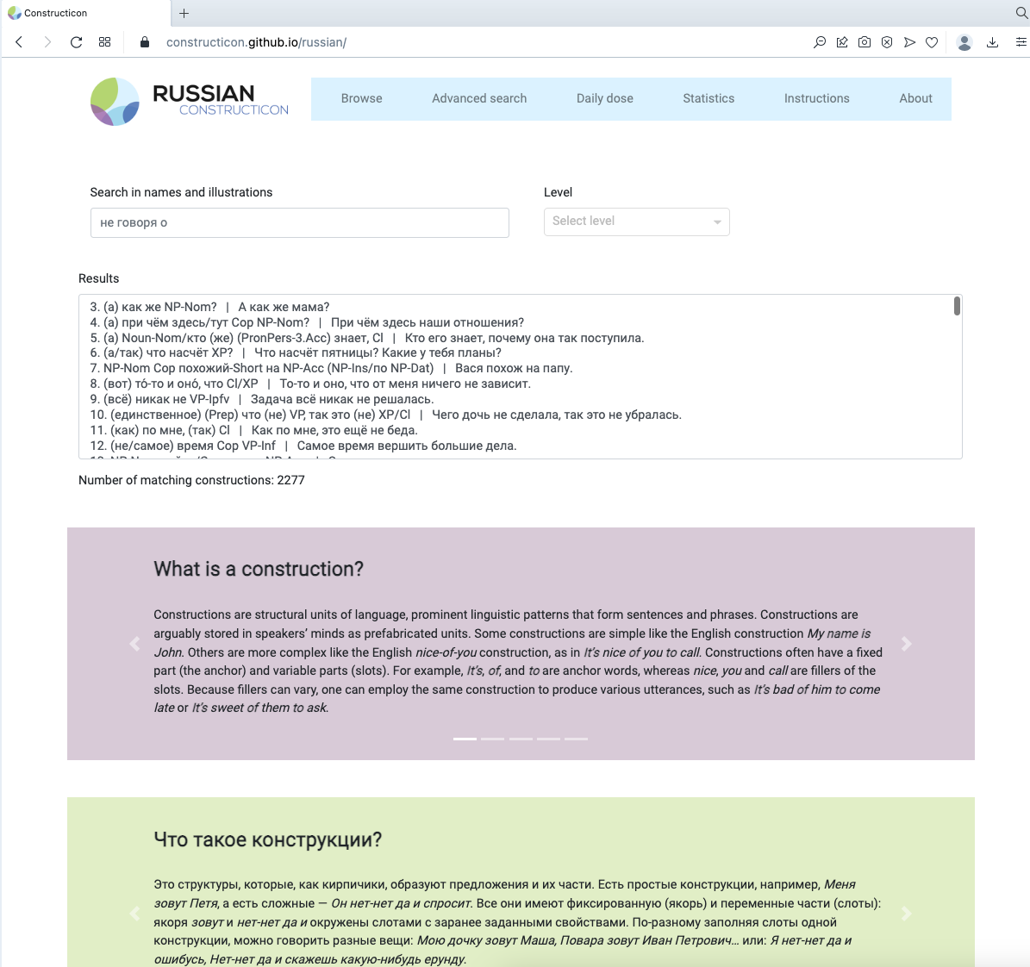
The Russian Constructicon
A searchable database of Russian constructions
Open access
Available at https://constructicon.github.io/russian/
Notes:
While it is probably impossible to compile an entirely comprehensive inventory of the constructions of a given language, our aim has been to gather enough constructions to realistically represent the repertoire of the Russian language as a whole. This project underwent continuous revision until a stable pattern of semantic and syntactic types emerged such that the addition of further constructions became a matter of filling out existing types rather than identifying new ones. The conventions devised and systems observed in this project thus relate to the Russian language in its entirety, giving us a macroscopic view on the place of reduplicative constructions in the language.

Slide 6
What gets repeated: anchor vs. slot
Slot (59 cxns)
Both anchor and slot (3 cxns)
Noun iz ~Noun-Gen.Pl
čud-o iz čud-es
miracle-nom.sg out_of miracle-gen.pl
‘a real miracle’
[lit. ‘miracle of miracles’]
ne Verb, tak ne ~Verb
Ne povez-l-o, tak ne povez-l-o!
neg be_lucky-pst.3sg-n so neg be_lucky-pst.3sg-n
‘Oh, unlucky, so unlucky!’
Anchor (56 cxns)
vremja ot vremeni Cl
Vrem-ja ot vrem-eni mne sni-l-sja Vadim.
time-acc.sg from time-gen.sg I.dat dream-pst.3sg-refl Vadim.nom.sg
‘From time to time I dreamed of Vadim.’

Slide 7
What gets repeated: part of speech
All parts of speech can be repeated
  Noun (45 cxns)
  Verb
  Adjective
  Adverb
  Pronoun
  Prefix
  XP (i.e. any phrasal unit)
  Preposition
  Conjunction
  Particle
  Onomatopoeic
Reduplicative cxns are very diverse

Slide 8
Modified vs. exact repetition
other words can get inserted
Noun iz ~Noun-Gen.Pl
čud-o iz čud-es
miracle-nom.sg out_of miracle-gen.pl
‘a real miracle’
[lit. ‘miracle of miracles’]
ne Verb, tak ne ~Verb
Ne povez-l-o, tak ne povez-l-o!
neg be_lucky-pst.3sg-n so neg be_lucky-pst.3sg-n
case and number
VP-Ipfv snova i snova
‘VP-Ipfv again and again’
Change of the morphological form
Part of speech derivation
Affixation
Notes:
malo-pomalu VP

Slide 9
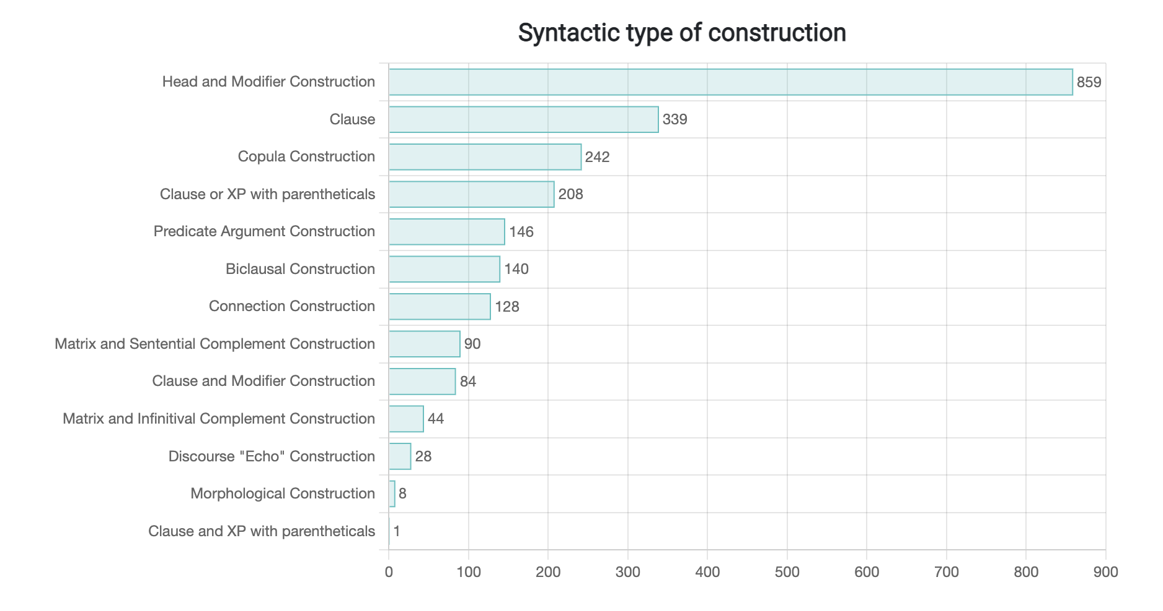
Distribution across syntactic types
In terms of syntax, reduplicative cxns present something like a microcosm of the entire RusCon
42 cxns
30 cxns
12 cxns
5 cxns
1 cxn
8 cxns
10 cxns
The constructions in our dataset are intensely interconnected both with each other and with the entire system of constructions represented in RusCon
1 cxn
1 cxn
25 cxns

Slide 10
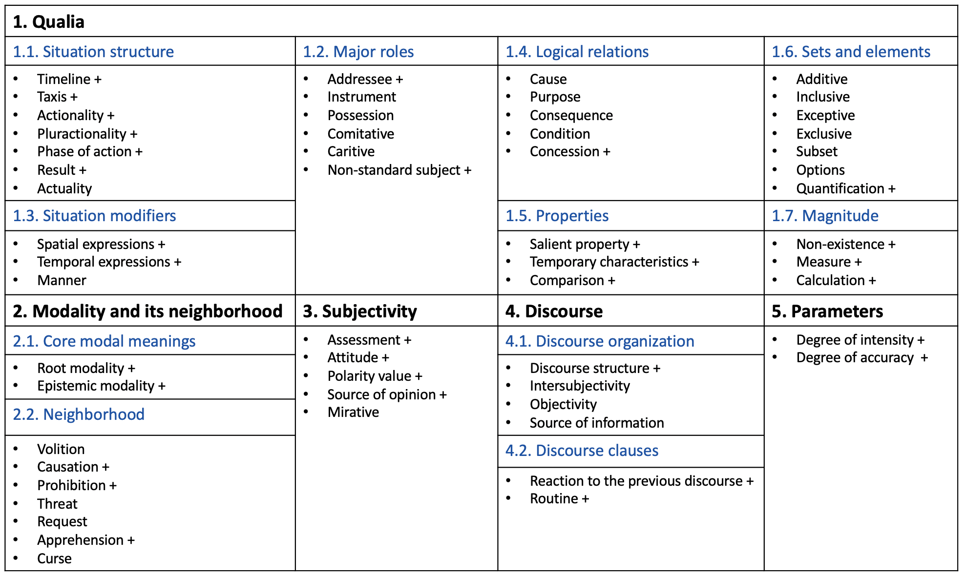
Distribution across semantic types
Altogether over half of the Semantic types found in RusCon are also found in our data
The majority of meanings refer to various extremes
However, many meanings are not predictable from typological research

Slide 11
Russian reduplicative cxns:
within and beyond a single clause
118
Reduplication cxns
28
Discourse “Echo” cxns
where repetition is observed within a clause
where repetition is observed across two clauses
Noun iz ~Noun-Gen.Pl
čud-o iz čud-es
miracle-nom.sg out_of miracle-gen.pl
‘a real miracle’ [lit. ‘miracle of miracles’]
Notes:
Now Lets take a closer look at the Russian reduplicative constructions.
On the one hand, we have 118 cxns where the repetition is observed within a clause. An example of such reduplication is the following constructioon:
On the other hand, there are 28 constructions where the repetition happens across two clauses.

Slide 12

Discourse “Echo” cxns
These constructions are larger than a clause. They always refer to and cite the preceding discourse, so we term them Discourse “Echo” constructions
Russian:
Skažešʹ tože – XP
– On takoj xoroš-ij! – Skaž-ešʹ tože – "xoroš-ij"!
he such nice-nom.sg.m say-fut.2sg also nice-nom.sg.m
‘–He’s so nice! –Hah, sure he’s “nice” ’.
[I actually do not think so!]
Notes:
Construction Grammar identifies all learned form-function associations as constructions, at all levels of complexity. Thus constructions are not limited to multi-word grammatical constructions. There are also constructions of smaller units, such as single words, morphemes, and even phonemes. Moving toward the opposite extreme, there are constructions that are larger than a single clause, or even larger than an utterance, on up to entire discourse structures (such as an interview or a sonnet). Today I want to discuss with you one particular type of constructions that are larger than a clause. They always refer to the preceding discourse and cite it thus creating an echo effect. I will refer to them as discourse echo constructions.
Here is one example of such Russian Construction. Imagine a conversation between two friends that discuss a guy.
To the best of our knowledge this type of constructions was not thoroughly studied yet
This is the first case study of a whole group of such cxns (28) based on the Russian Constructicon data

Slide 13
Russian reduplicative cxns:
within and beyond a single clause
No clear-cut boundary
118
Reduplication cxns
28
Discourse “Echo” cxns
where repetition is observed within a clause
5
cxns belong
to both groups
where repetition is observed across two clauses
This type of cxns expands the definition of reduplication
Notes:
Our data shows that they are not distinct categories but they overlap
To be precise the picture looks like this. The two groups overlap because 5 cxns have both inter and intra-clausal repetition. We suggest that This, second, type of cxns expands the definition of reduplication. First of all, because, despite crossing the clausal boundary, echo cxns involve regular repetition. And secondly, because we see that there is no clear-cut boundary between the two groups.
Let’s discuss one such example.

Slide 14



Reduplication both within & beyond a clause
(nu) XP i ~XP
Byl u tet-i Maš-i kot. Nu kot i kot. Ničego osobennogo.
was at aunt-GEN.SG Masha-GEN.SG cat-NOM.SG. well cat-NOM.SG and cat-NOM.SG nothing special
‘Aunt Masha had a cat. Well, it was just a cat. Nothing special.’
The inner monologue of the speaker constructed as a conversation of the speaker with him/herself
Assessment:
Assessment in relation to norms/expectations
Attitude: Unconcern
Notes:
Here is one such construction.
Repetition INSIDE
Practicallly any phrasal unit can fill the slot instead of a noun

Slide 15
Properties of Discourse “Echo” cxns: Semantics
almost all of them are colloquial and exclamatory
Agreement
Disagreement
Doubt
Insight
Self-evidence
Surprise
Notes:
In the system of semantic classification
Available online
Most Discourse “Echo” constructions express Agreement, Disagreement, or Surprise, though there is some variation here too.

Slide 16


Properties of Discourse “Echo” cxns: Structure
1. “Echo” cxns pick up something in the previous discourse, repeat the element (often quote it in the same morphosyntactic form) and add a comment
2. Previous context is crucial for understanding constructions of this type. But usually it is not represented in the morphosyntactic formula of the cxn
Skažešʹ tože – XP
{XP} Skažešʹ tože – ~XP
3. “Echo” cxns usually (prototypically) attested within a dialogue
4. Normally, the same cxn can be used in both situations (dialogue or inner monologue)
standard situation
less frequent situation
Notes:
These constructions show how the speaker reacts to the statement of the interlocutor or the speaker's own statements.
More precise way of representing the syntactic structure
Such constructions also occur when presenting the inner monologue of the speaker that is constructed as a conversation in which the speaker is talking to him- or herself.
These constructions show how the speaker reacts to the statement of the interlocutor, therefore,

Slide 17
Properties of Discourse “Echo” cxns:
Co-creation of discourse
The negotiation of meaning among interlocutors is understudied
(with notable exceptions, e.g., Hopper 1988, Schegloff 1991, Ono and Thompson 1995, Helasvuo 2001, Mesch et al. 2015)
“Echo” cxns result from interaction & communication of at least 2 speakers
Unresolved issues
How to conduct corpus searches?
Should the clauses be adjacent or allow for some distance?
{XP}
Skažešʹ tože ~XP
Notes:
Echo cnxs are particularly interesting as they serve as an example of co-creation of discourse. These cxns result from the verbal interaction of at least two speakers. The construction, therefore, isn’t split just between the two clauses but between the two speakers.
These cxns also bring certain challenges to us. For instance, how to conduct corpus searches for them? Especially if these clauses are not adjacent to each other.

Slide 18
Summing up
Russian shows a great number and variety of repetition constructions that represent nearly all types identified for reduplication-friendly languages
In Russian reduplicative cxns, repetition can be whole, partial, or entail modification
Discourse “Echo” constructions, which have non-trivial properties in terms of semantics and structure, expand the scope of reduplication beyond clause boundaries
Discourse “Echo” cxns are born in the moment of verbal interaction between two speakers
Notes:
Based on the data that is gathered in the Russian Constructicon, reduplication is better understood broadly. It involves repetition of an element that is attested both within and across the clause boundary. The latter type is called discourse echo type of constructions. These cxns have non-prototypical semantic and structural properties. The most important one is that these constructions are literally born in the moment of verbal interaction between two speakers.
This phenomenon raises important questions to construction grammar
Where do the boundaries of cxns lie?
What criteria can help to establish these boundaries?
Can speakers in a conversation co-create a single cxn?

Slide 19
Thank you!

Slide 20
References
Freywald, Ulrike and Rita Finkbeiner. 2018. Exact repetition or total reduplication? Exploring their boundaries in discourse and grammar. In Rita Finkbeiner and Ulrike Freywald (eds.), Exact Repetition in Grammar and Discourse, 3–28. De Gruyter Mouton.
Helasvuo, Marja-Liisa. 2001. Syntax in the Making: The emergence of syntactic units in Finnish conversation. John Benjamins.
Hopper, Paul J. 1988. Emergent Grammar and the A Priori Grammar Postulate. In Deborah Tannen (ed.), Linguistics in Context, 117–134. Ablex.
Lyngfelt, Benjamin, Linnéa Bäckström, Lars Borin, Anna Ehrlemark & Rudolf Rydstedt. 2018. Chapter 3. Constructicography at work: Theory meets practice in the Swedish constructicon. In Lyngfelt, B., Borin, L., Ohara, K., & Torrent, T. T. Constructicography (Vol. 22). John Benjamins Publishing Company. https://doi.org/10.1075/cal.22.03lyn
Mesch, Johanna, Eli Raanes, and Lindsay Ferrara. 2015. Co-forming real space blends in tactile signed language dialogues. Cognitive Linguistics 26(2), 261–287. DOI 10.1515/cog-2014-0066
Moravcsik, Edith. 1978. Reduplicative constructions. In: Joseph H. Greenberg (Ed.), Universals of human language, vol. 3, 297–334. Stanford University Press.
Schegloff, Emanuel. 1991. Conversation Analysis and Socially Shared Cognition. In Lauren Resnick, John Levine and Stephanie Teasley (Eds.), Perspectives on Socially Shared Cognition, 150–171. American Psychological Association.
Ono, Tsuyoshi & Sandra A. Thompson. 1995. What can Conversation tell us about Syntax? In Philip Davis (ed.), Alternative Linguistics: Descriptive and Theoretical Modes. Current Issues in Linguistic Theory, vol. 102, 213–271. John Benjamins.

Slide 21
Extra slides

Slide 22
Reviewer comments (if any)
The abstract first employs the term “repetition construction”, which accurately describes type (2), but then switches to “reduplicative construction”. I do not see how the latter term describes type (2). What do the authors understand by reduplication?
The authors have evidently prepared a subset based on the rich material of constructions that are publicly available via RusCon. There is no doubt that Russian is indeed rich in constructions that involve some sort of repetition. From this abstract, I understand that the authors have a rather long catalogue of such constructions.
At the same time, it remains unclear whether the authors go beyond the descriptive level and explore any substantial questions based in the data at their disposal. I suggest that in the case of acceptance, the authors focus on one or several potential issues, such as:
- Is Russian different from any other language wrt its use of reduplication?
- Is there any systematic co-variance between form and function in the domain of Russian reduplicative constructions?
- Do the data extracted from RusCon corroborate or contradict observations on reduplication in Russian that had been made previously?
- Do the figures arrived at by the authors imply any conclusions with respect to the niche occupied by the reduplicative constructions?
- The authors claim that reduplicative constructions are “well integrated” into the system of Russian constructions. How can this claim be tested or falsified? What kind of empirical observations could have made the authors believe otherwise?

Slide 23

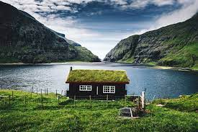

Not just in Russian: example from Norwegian
– Har | du | hus?
have | you | house.SG
‘– Do you have a house?’
– Hus | og | hus, | fru | Blom, | det | er | mer | ei | hytte...
house.SG | and | house.SG | Mrs. | Blom | it | is | more | a | cabin
‘– Yes and no / I do not quite agree, it is more like a cabin.’
≠
the speaker’s disagreement with an evaluation made by the conversation partner
The Swedish Constructicon: reaktiv_X_och_X ‘reactive x and x’
(Lyngfelt et al. 2018: 80):
“It picks up an expression X from the previous utterance and repeats it twice, normally followed by a clarification, to indicate that the expression X is not quite adequate in the present context”
Notes:
Finally, a quick example from Norwegian. Imagine two friends talking to each other. One is asking: har du hus? Do you have a house. And the other answers: – Hus og hus, fru Blom, det er mer ei hytte.... The speaker disagrees with the interlocutor suggesting that the house that he has doesn’t match the definition of a proper house.
The Swedish Constructicon contains a similar construction with the same function. The phenomenon therefore is not particular to Russian and can be observed in other languages too.

Slide 24
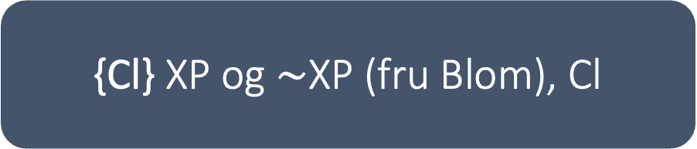
Example from Norwegian
– Har du hus?
– Hus og hus, fru Blom, det er mer ei hytte...
‘– Do you have a house?
– Yes and no, it is more like a cabin.’
– Det var et fint maleri.
– Fint og fint, fru Blom!
– Liker du det ikke?
– Det er vel ikke akkurat det fineste jeg har sett.
– Legger du deg tidlig?
– Legger meg tidlig og legger meg tidlig, jeg tenkte å se litt på film og spise popkorn...
{Cl} XP og $\sim$XP (fru Blom), Cl

Slide 25
Overlap: reduplication & “Echo”
ne Noun, a ~Noun-išče
Èto by-l-o ne bolot-o, a bolot-išč-e.
this be-PST-3SG NEG swamp-NOM.SG but swamp-AUG-NOM.SG
‘It wasn’t just a swamp, it was a monster [huge] swamp.’
Morphologically
modified repetition
Notes:
Or should I take a previous context too?

Slide 26
Russian reduplicative cxns: within and beyond a single clause
No clear-cut boundary
118
Reduplication cxns
28
Discourse “Echo” cxns
where repetition is observed within a clause
5
cxns belong
to both groups
where repetition is observed across two clauses
Noun iz ~Noun-Gen.Pl
čud-o iz čud-es
miracle-nom.sg out_of miracle-gen.pl
‘a real miracle’ [lit. ‘miracle of miracles’]
This type of cxns expands the definition of reduplication
Skažešʹ tože – XP
Notes:
Перекрасить кружочки
Traditionally such cxns are not considered reduplicative
But in our data

Slide 27
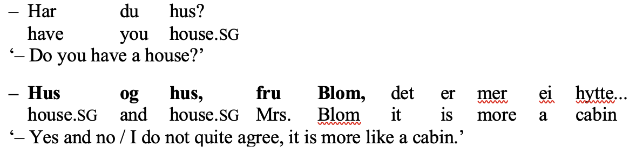
Not just in Russian
Swedish: reaktiv_X_och_X ‘reactive x and x’ (Lyngfelt 2018: 80):
  “It picks up an expression X from the previous utterance and repeats it twice, normally followed by a clarification, to indicate that the expression X is not quite adequate in the present context”
Norwegian: {Cl} XP og XP (Fru Blom), Cl
  encoding the speaker’s disagreement with an evaluation or statement made by the conversation partner:

Slide 28
Reduplication in Russian is systematic
Reduplication is found in nearly all Syntactic types and all of the most frequent Semantic types in the Russian Constructicon.
All parts of speech as well as entire clauses or phrases can be repeated.

